Slide 1
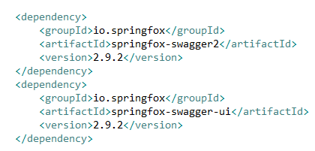
Spring Boot - Enabling Swagger2
Swagger2 is an open source project used to generate the REST API documents for RESTful web services.
It provides a user interface to access our RESTful web services via the web browser.

Slide 2
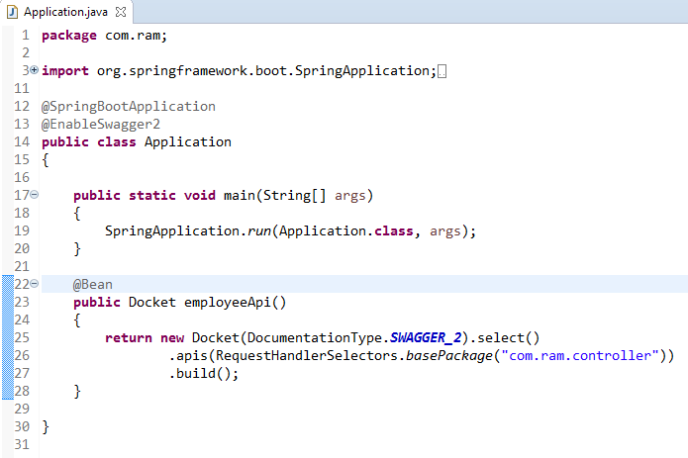
Spring Boot - Enabling Swagger2
@EnableSwagger2 annotation is used to enable the Swagger2 for your Spring Boot application.
Create Docket Bean to configure Swagger2 for your Spring Boot application. We need to define the base package to configure REST API(s) for Swagger2.

Slide 3
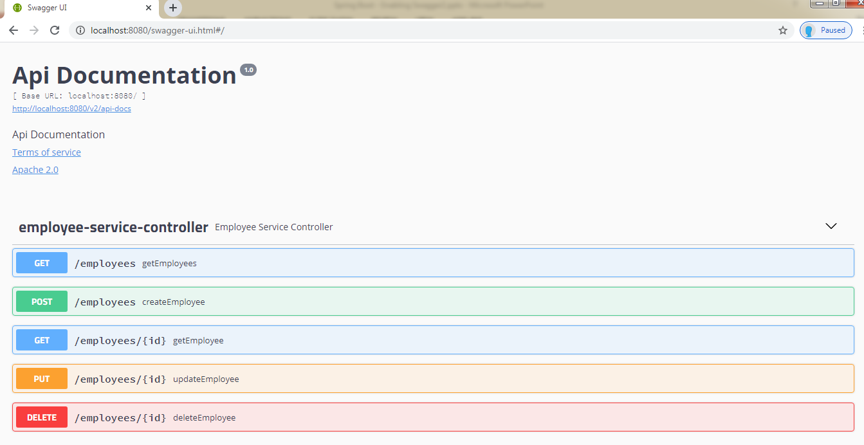
Spring Boot - Enabling Swagger2
http://localhost:8080/swagger-ui.html

